Slide 1
NLP

Slide 2
Introduction to NLP
Dependency Grammars

Slide 3
Dependency structure
blue
house
blue
modifier, dependent, child, subordinate
house
head, governor, parent, regent

Slide 4
Dependency Structure
Unionized workers are usually better paid than their non-union counterparts.
1 2 3 4 5 6 7 8 9 10

Slide 5
Dependency Structure
Unionized workers are usually better paid than their non-union counterparts.
1 2 3 4 5 6 7 8 9 10

Slide 6
Dependency Structure
Unionized workers are usually better paid than their non-union counterparts.
1 2 3 4 5 6 7 8 9 10

Slide 7
Dependency Structure
Unionized workers are usually better paid than their non-union counterparts.
1 2 3 4 5 6 7 8 9 10

Slide 8
Other notations
VBN
nsubjpass
prep
auxpass
advmod
advmod
NNS
VBP
RB
RBR
IN
amod
poss
JJ
NNS
poss
amod
PRP$
JJ
Unionized workers are usually better paid than their non-union counterparts.
1 2 3 4 5 6 7 8 9 10

Slide 9
Phrase Structure
S
NP
VP
VP
ADVP
PP
NP
JJ
NNS
VBP
RB
RBR
VBN
IN
PRP$
JJ
NNS
Unionized workers are usually better paid than their non-union counterparts.
1 2 3 4 5 6 7 8 9 10

Slide 10
Dependency grammars
Characteristics
Lexical/syntactic dependencies between words
The top-level predicate of a sentence is the root
Simpler to parse than context-free grammars
Particularly useful for free word order languages
Older idea compared to constituent grammars (as far back as Pāṇini (5th century BCE)

Slide 11
How to identify the heads
H=head, M=modifier
H determines the syntactic category of the construct
H determines the semantic category of the construct
H is required; M may be skipped
Fixed linear position of M with respect to H

Slide 12
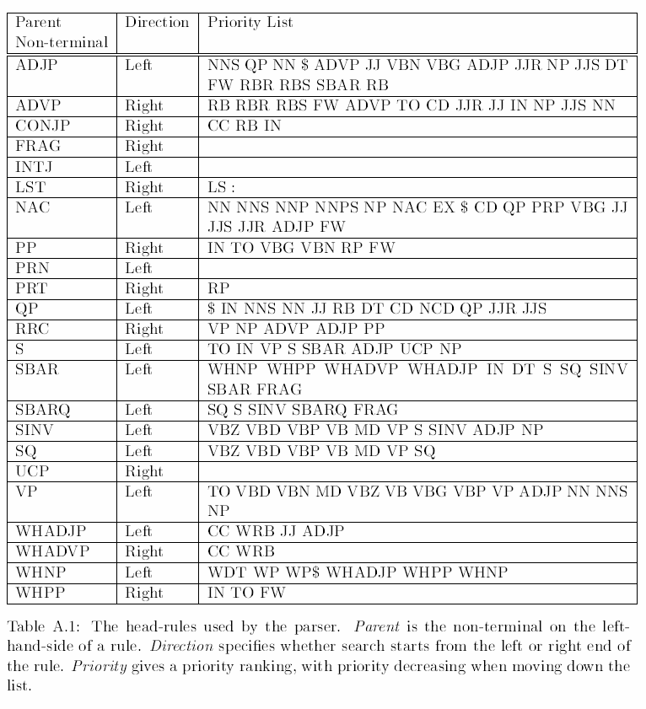
Head Rules from Collins’s Thesis
Notes:
PROVENANCE!

Slide 15
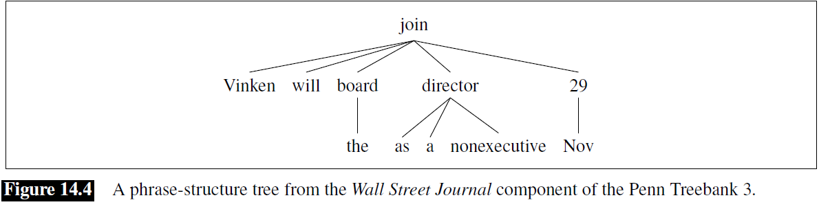

Slide 16
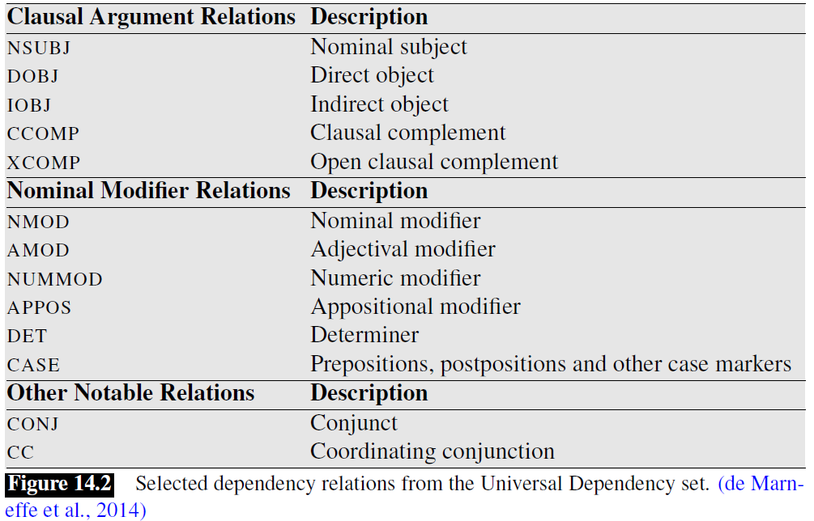

Slide 19
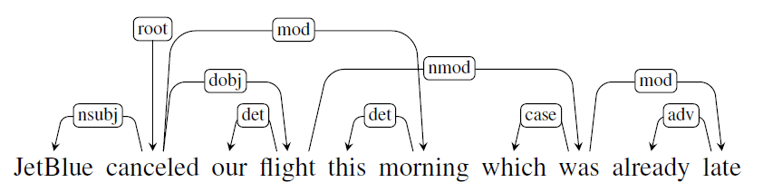

Slide 20
Non-Projectivity
Rare in English
Topicalization
Cats, I like a lot.
Extraposition
The pizza is ready with pepperoni.
Notes:
CHECK!

Slide 21
Non-projectivity
Output of Stanford parser
advmod(come-4, Where-1)
aux(come-4, did-2)
nsubj(come-4, you-3)
root(ROOT-0, come-4)
prep(come-4, from-5)
amod(year-7, last-6)
pobj(from-5, year-7)
Output of (the non-projective) MSTParser
Where
did
you
come
from
last
year
1 Where Where WRB WRB - 2 SBJ - -
2 did did VBD VBD - 0 ROOT - -
3 you you PRP PRP - 4 SBJ - -
4 come come VBP VBP - 2 VC - -
5 from from IN IN - 4 DIR - -
6 last last JJ JJ - 7 NMOD - -
7 year year NN NN - 5 PMOD - -
8 ? ? . . - 2 P - -

Slide 22
Notes
How to extend a projective method for non-projective parses
Use a SWAP operator (Nivre 2009)
Not clear what to do with conjunctions
“cats, dogs, and hamsters”
Options: “cats” or “and”

Slide 23
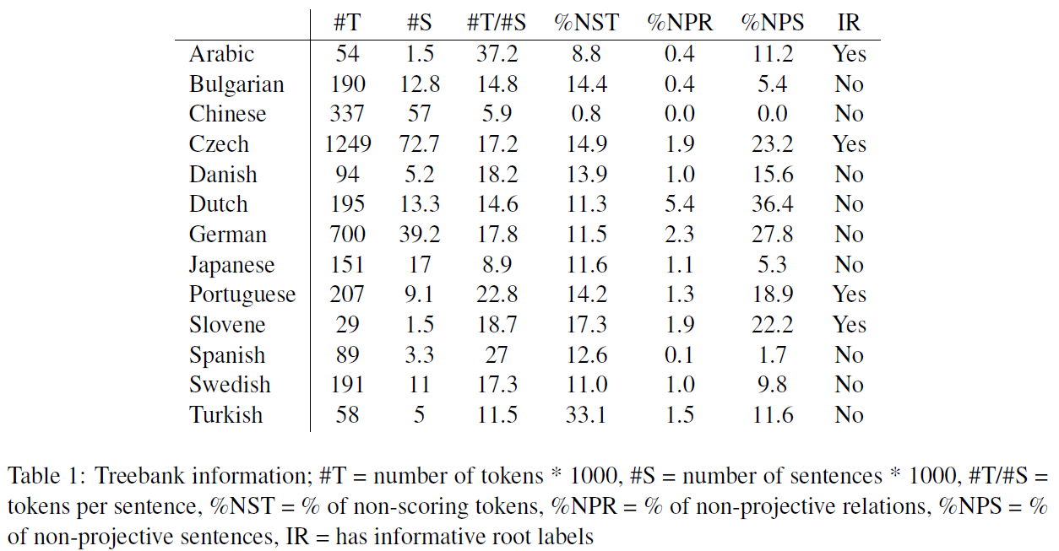
Rate of Non-Projectivity
[CoNLL-X data: Hall and Nilsson 2006]

Slide 24
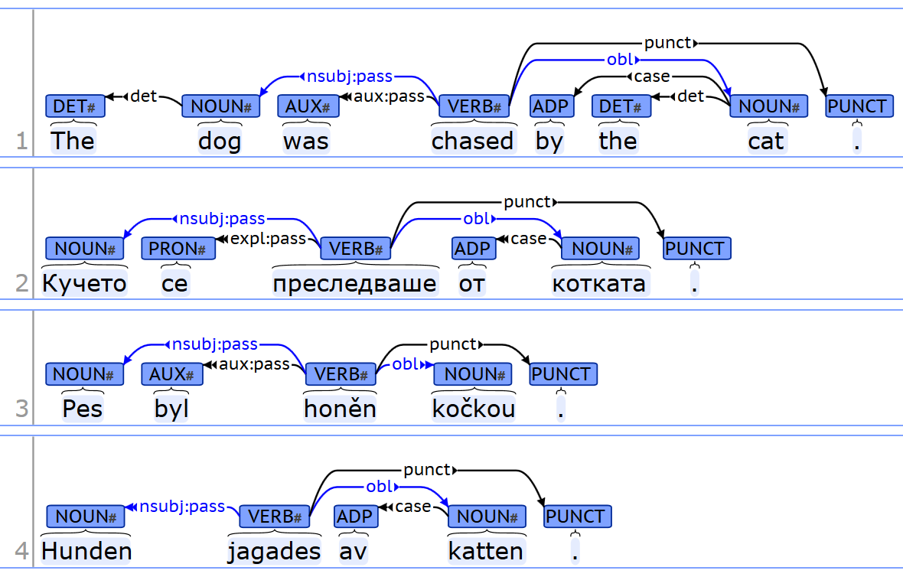
https://universaldependencies.org/

Slide 25
NLP

